Slide 1
Private Duty Nursing
Provider Training
2024
Presented by:
Staff Development & Training Unit

Slide 2
Objectives
Review CCS medical eligibility requirements to qualify for PDN services
Review how to submit PDN SAR request(s)
Introduce the PDN SAR Provider Tool and discuss what information is required by CCS to process PDN SAR(s) request
Explain how to view information on PEDI System
Summarize key points r/t PDN SAR request
Resources

Slide 3

Medical Eligibility

Slide 4
CCS Medical Eligibility
PDN services must be medically necessary to correct or ameliorate the CCS medically eligible condition.
Medical necessity for PDN services is determined on a case-by-case basis depending on the individual needs of the CCS client.
PDN requests are evaluated by the same process applied to any benefit request of the CCS program, though they are one of the most complex benefits to assess.

Slide 5
CCS Medical Eligibility
CCS will review the complexity of the medical necessity criteria-level of care, number of hours, provider’s qualification and availability of other resources.
PDN services will not be approved when the care is for the following:
  Child’s intellectual disability or behavior
  Personal care services (i.e., directed at grooming, hygiene, feeding)

Slide 6

CCS SAR Referral

Slide 7
CCS SAR Referral
PDN provider may submit a referral to Los Angeles County-CCS local office via:
  Fax Submission-1-855-481-6821
  Electronic Submission via PEDI System
  Mail to: California Children Services
    9320 Telstar Ave. #226, El Monte, Ca 91731

Slide 8

PDN SAR Tool

Slide 9
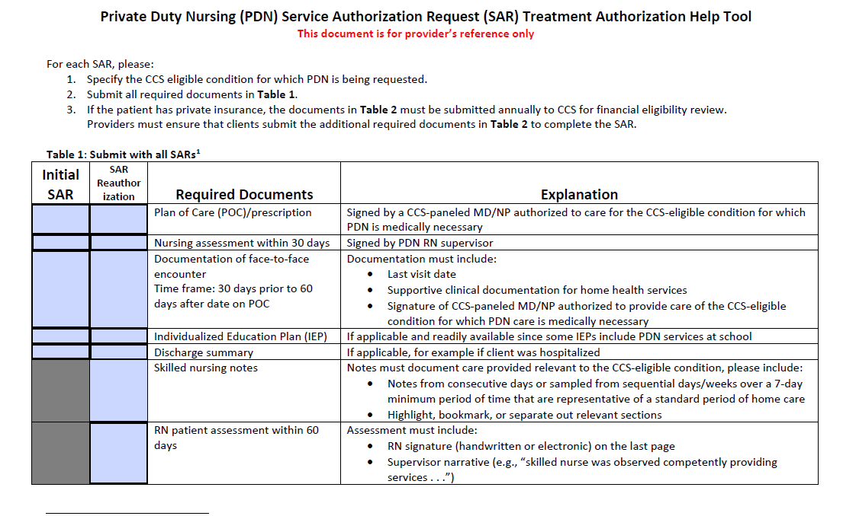

Slide 10
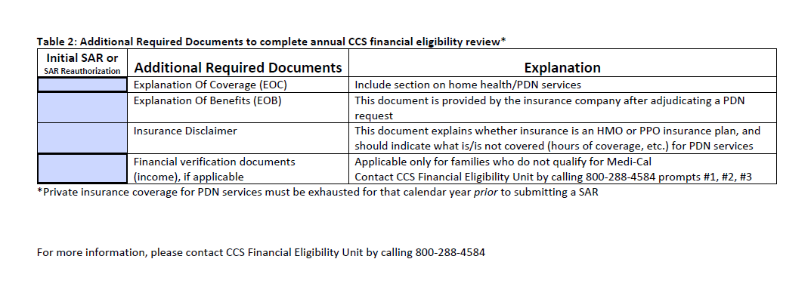

Slide 11
SAR Provider Tool
The tool was developed to assist providers with requirements needed to properly submit PDN request.
Let’s review what is needed when submitting PDN SAR request:
  Plan of Care: Signed by CCS-paneled MD authorized to care of the CCS medically eligible condition.
  Nursing assessment within 30 days: Signed by PDN RN supervisor.

Slide 12
SAR Provider Tool
Let’s review what is needed when submitting PDN SAR request: (cont.…)
  Documentation of face-to-face encounter
  Individual Education Plan (IEP), if client attends school
  Skilled Nursing Notes-consecutive days over a 7-day minimum period that are representative of a standard period of home care
  RN patient assessment within last 60 days

Slide 13
SAR Provider Tool
Let’s review what is required when submitting PDN SAR request for client’s who have been identified as having commercial insurance:
  Insurance disclaimer
  Explanation of Benefits or Explanation of Coverage
  Denial Letter
  Financial verification documents (income), if applicable.

Slide 14
SAR Provider Tool
Initial PDN SAR(s): PDN providers will have 15 days to provide CCS with missing medical documentation (i.e., missing LVN logs, face-to-face information).
If the plan of care is not complete or missing from SAR request, provider will have 30 days to submit.
If insurance or financial information is incomplete, provider or family will have up to 60 days to provide requested information. May be extended if insurance company or family is in the process of submitting documentation.

Slide 15

PEDI System

Slide 16
PEDI System
A web-based tool that enables CCS-approved providers to electronically access the following:
  Status of SAR request and authorizations
  Print authorizations, denials, reports, and correspondence
  Track referrals
  Submit e-SARs

Slide 17
PEDI System
Apply on-line:
  https://cmsprovider.cahwnet.gov/PEDI/login.jsp
Help Desk: 626-569-6630 or 1-866-685-8449

Slide 18
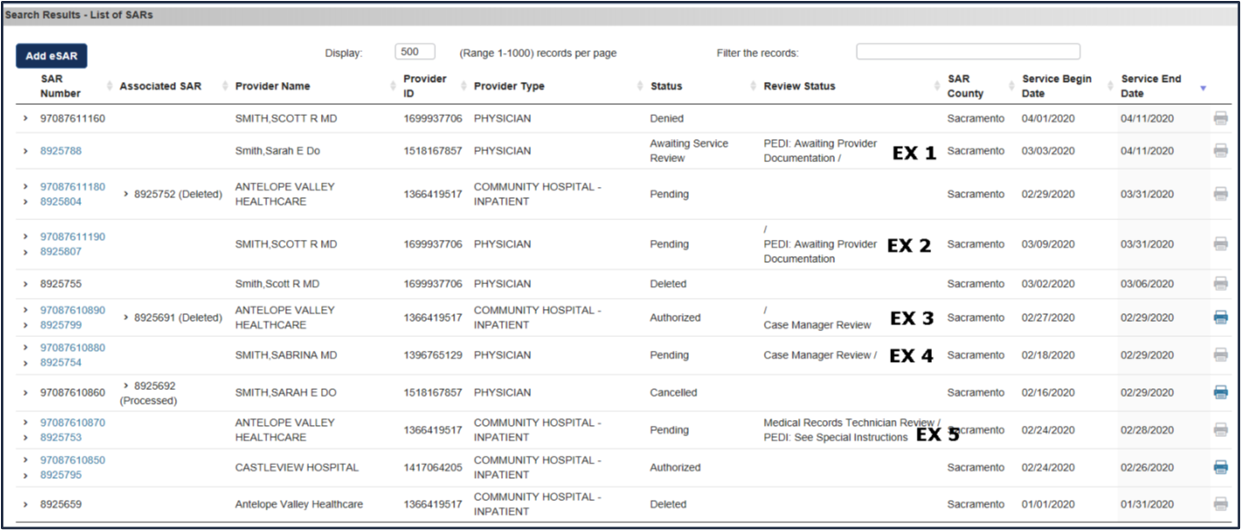
PEDI-SAR System
Provider may view status of request via PEDI-SAR System

Slide 19
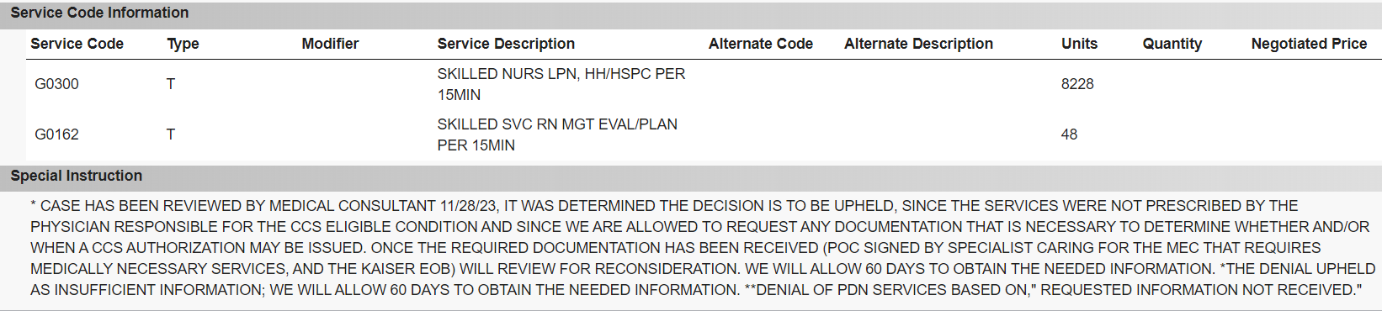

Slide 20


Slide 21
PDN Key Points
Complex benefit, both to request and review.
Requires the involvement of multiple individuals:
  the treating CCS physicians and specialists
  the home health agency
  the family
  CCS nurse case managers and CCS physicians
  In some cases-CCS medical therapy unit, the school system and regional center(s).

Slide 22
PDN Key Points
Complicated in cases where client has private insurance when PDN may or may not be a benefit.
CCS will determine the least expensive provider type that can be authorized to provide the requested services.
In some cases, CCS may only approve a portion of the PDN hours requested on a SAR. It will be your responsibility to seek payment or approval from other payor source.

Slide 23
PDN Key Points
If CCS denies PDN services, the client/family may disagree with a CCS determination.
The client/family are the only individuals that can file a formal written appeal. A provider may not appeal decisions made by CCS.
PDN providers may request a reconsideration.

Slide 24


Slide 25
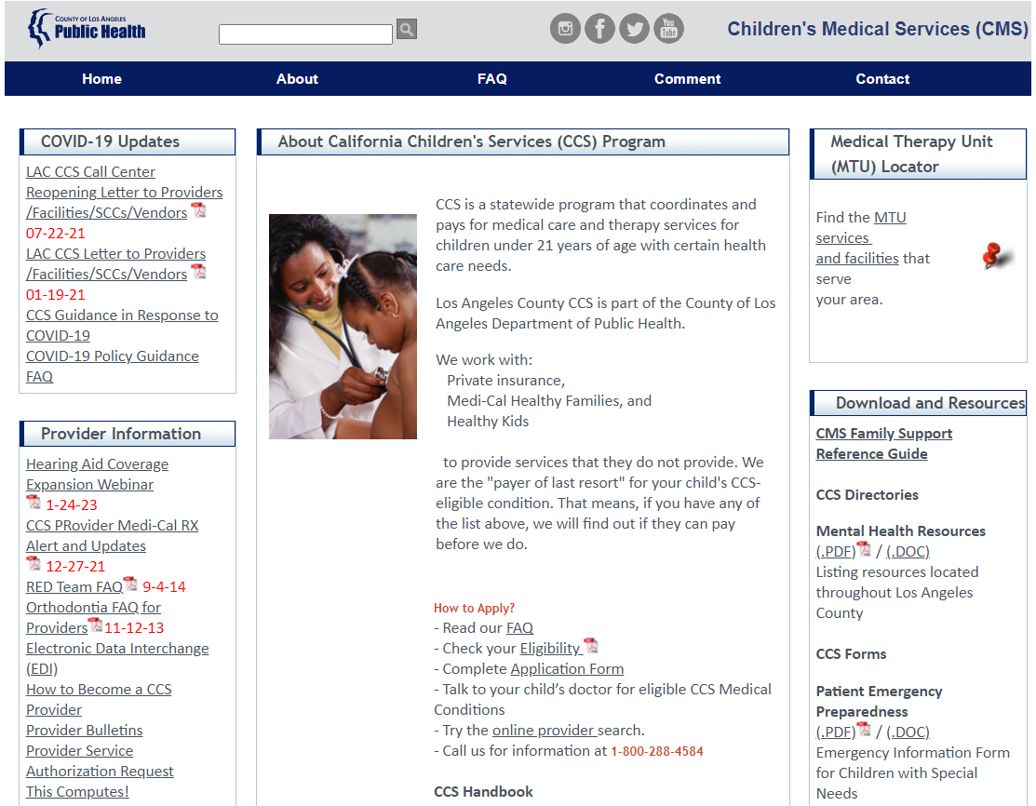
Resources
If you have questions regarding your SAR request. Please contact CCS at 1-800-288-4584 or visit or LA County CCS website at: http://publichealth.lacounty.gov/cms/ccs.htm

Slide 26


